Slide 1
An Efficient and Usable Client-Side Cross Platform Compatible Phishing Prevention Application
FINAL YEAR PROJECT REPORT
Submitted by
N. Dhanush 2016103021
G. Santhosh 2016103057
S. Ben Stewart 2016103513

Slide 2
OUTLINE
INTRODUCTION
OVERALL OBJECTIVE
LITERATURE SURVEY
PROPOSED SYSTEM
SYSTEM ARCHITECTURE
REFERENCES

Slide 3
INTRODUCTION
Phishing
Lists of such sites
Time constraints
Computational resources
Vulnerabilities
Cross platform

Slide 4
OVERALL OBJECTIVE
Create a phishing list
Cross Platform application
Web browser add-on
Provide temporal resilience
Remove false positives from list

Slide 5
LITERATURE SURVEY
Previous work by Samuel Marchal, Giovanni Armano, Tommi Grondahl, Kalle Saari, Nidhi Singh, and N. Asokan
Implemented a client-side phishing prevention application.
Had background tasks communicate with a browser add-on.
Not platform independent.

Slide 6
PROPOSED SYSTEM
Platform independent
Browser add-on
Reduce false warnings
Split words properly
Context independent detection
Static observations

Slide 7
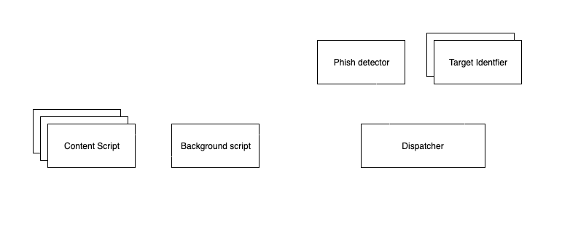
SYSTEM ARCHITECTURE

Slide 8
REFERENCES
S. Marchal, G. Armano, T. Gröndahl, K. Saari, N. Singh, N. Asokan, "Off-the-hook: An efficient and usable client-side phishing prevention application", IEEE Trans. Comput., vol. 66, no. 10, pp. 1717-1733, Oct. 2017.
A. K. Jain, B. B. Gupta, "A novel approach to protect against phishing attacks at client side using auto-updated white-list", EURASIP J. Inf. Secur., vol. 2016, no. 1, Dec. 2016.
G. Xiang, J. Hong, C. P. Rosé, L. Cranor, "CANTINA: A feature-rich machine learning framework for detecting phishing Web sites", ACM Trans. Inf. Syst. Secur., vol. 14, no. 2, 2011.
Implementation for the Usage of Google Safe Browsing APIs (v4), 2019, [online] Available: https://github.com/google/safebrowsing.
C. Whittaker, B. Ryner, and M. Nazif, “Large-scale automatic classification of phishing pages,” in Proc. Netw. Distrib. Syst. Security Symp., 2010, pp. 1–14.

